Slide 1
New Air-line Controller ‘s Architecture
Present by : Air-line team

Slide 2
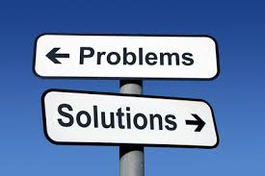
What Are We Talking About ?
Spaghetti Code
Hard to maintain
Unstable
Near impossible to apply Unit-Test
Multiple projects with same logic
Spending too much effort to investigate
Maintainability
Testability
Reusability
Scalability
Single API for all Air-lines
Flexible for extend or override
Reduce the development and investigate time
Clean Structure

Slide 3
Agendas
Overview
Objectives
Architecture’s Details & Demonstration
Technologies
Improvements & Ideas
Plan & Goal
QA
References

Slide 4
Objectives
Introducing the new Architecture.
Improving our Air-line Controller.
Adapting new businesses.
Finalizing our Goal and Plan.
Sharing Ideas.

Slide 5
Agendas
Overview
Objectives
Architecture’s Details & Demonstration
Technologies
Improvements & Ideas
Plan & Goal
QA
References

Slide 6
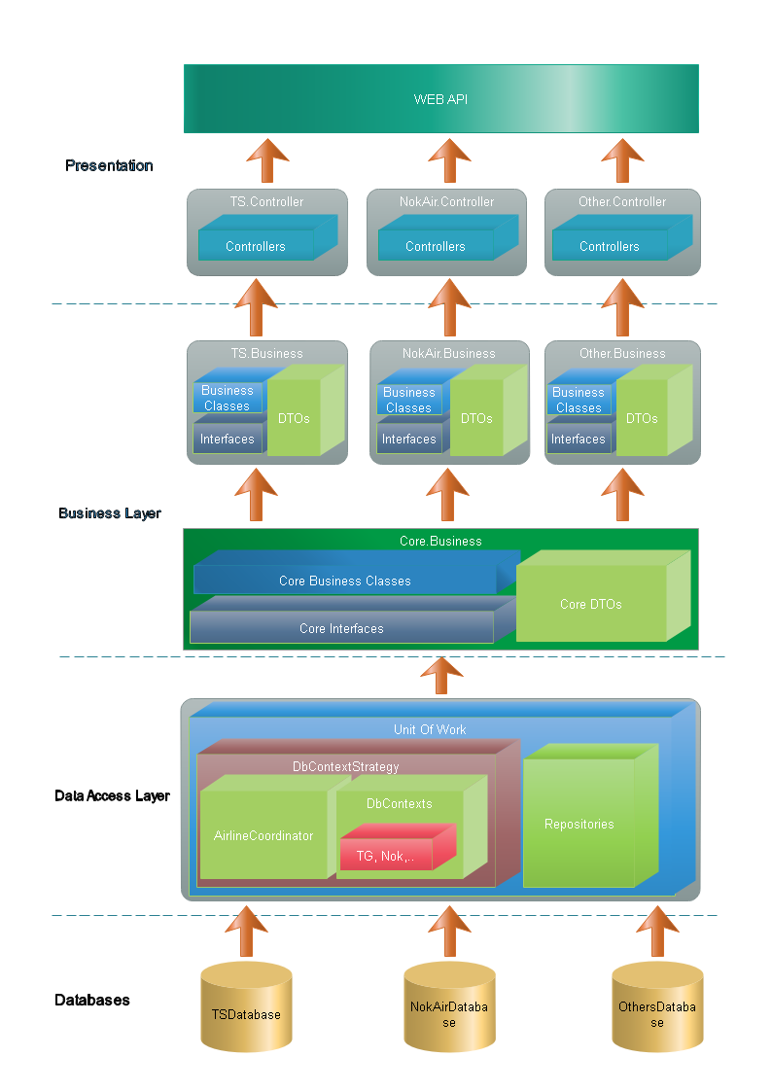
Architecture’s Details

Slide 7
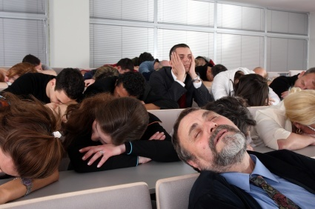
Demonstration

Slide 8
Agendas
Overview
Objectives
Architecture’s Details & Demonstration
Technologies
Improvements & Ideas
Plan & Goal
QA
References

Slide 9













Technologies
FRONT-END
BACK-END

Slide 10
Agendas
Overview
Objectives
Architecture’s Details & Demonstration
Technologies
Improvements Ideas
Plan & Goal
QA
References

Slide 11
Improvements & Ideas
Improvements
Applying multiple configurations management.
Define the new log template.
Defining the base business for ALC
Ideas
Consist our UI behaviors.
Improving our User Exp.

Slide 12
Agendas
Overview
Objectives
Architecture’s Details & Demonstration
Technologies
Improvements & Ideas
Plan & Goal
QA
References

Slide 13
Plans and Goals
Plans
Goals
Define the common business from our Airlines (Suggestion: From TG).
Apply new ver on Payment API, Action.
NonUI 3DS
NonUI Non 3DS
Define Business flow an functionality on Admin Portal for all Airlines.
We suggest to have 4 working days/ month to work on new V2.
We will have a INNOVATION MEETING Every 2 weeks.
The first goal for one month is define common and non - businesses for ALC.
Applying new Payment API & Action, NonUI 3DS, Non 3DS to real project.

Slide 14
Agendas
Overview
Objectives
Architecture’s Details & Demonstration
Technologies
Improvements Ideas
Plan & Goal
QA
References

Slide 15

Question & Answer

Slide 16
Agendas
Overview
Objectives
Architecture’s Details
Technologies
Improvements Ideas
Plan & Goal
QA
References

